Slide 1
Crime & Cannabis Legality

Slide 2
Questions
How do crime rates differ between states?
How does cannabis legal status relate to different types of crime?
Do states with different legal statuses for cannabis have different crime rates?
How does cannabis legal status affect crime rates?

Slide 3
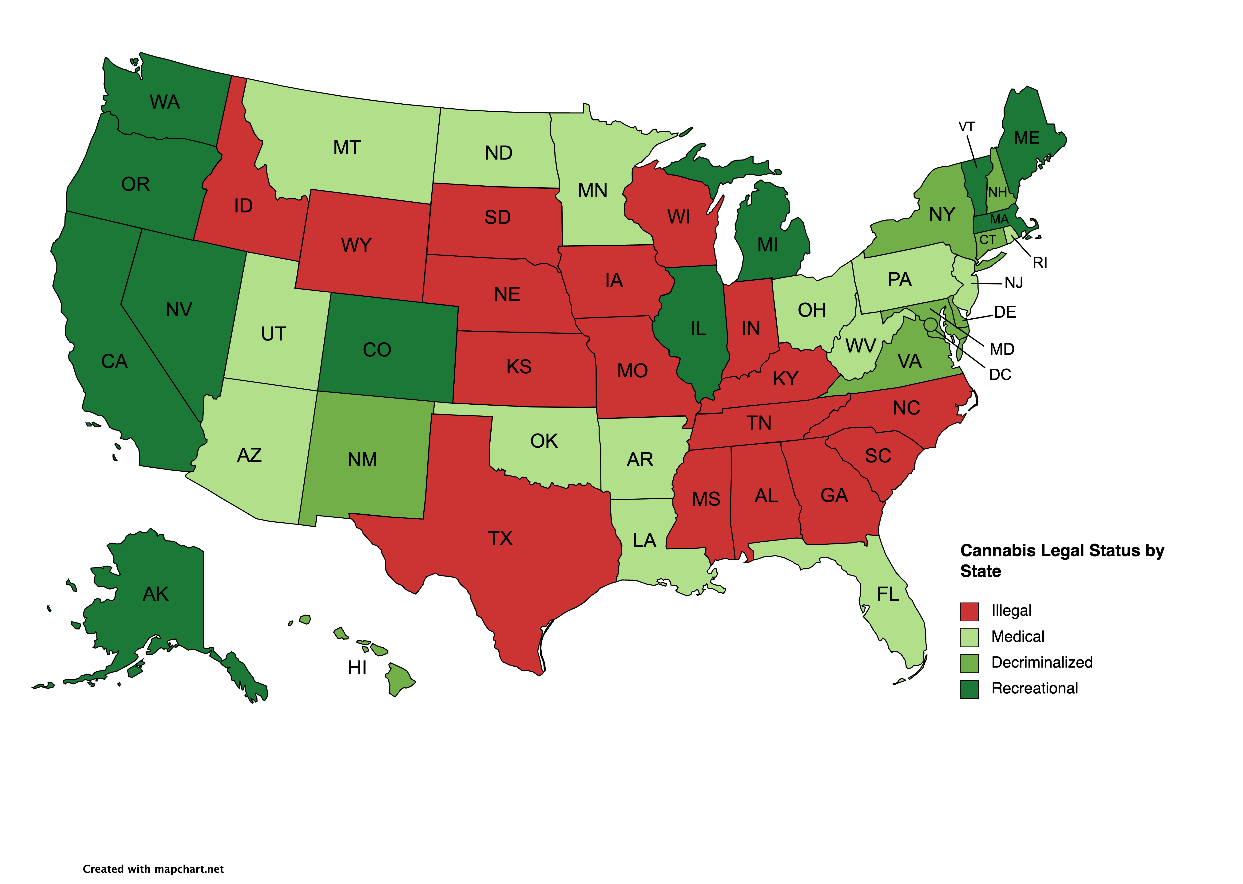
Cannabis Legal Status

Slide 4
Data Sources: And limitations
What data we have: What categories for which year and where we got it from

Slide 5
Why data is incomplete – blame the states/districts/ lack of federal reporting standards

Slide 6
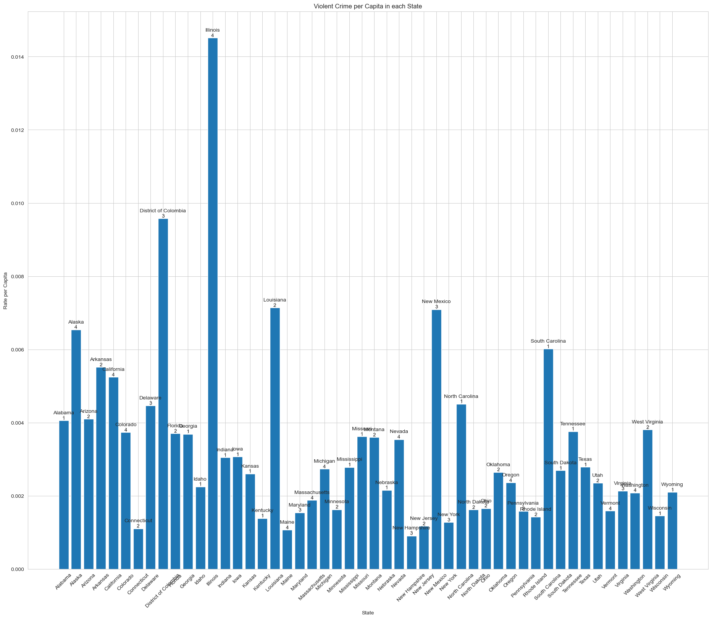
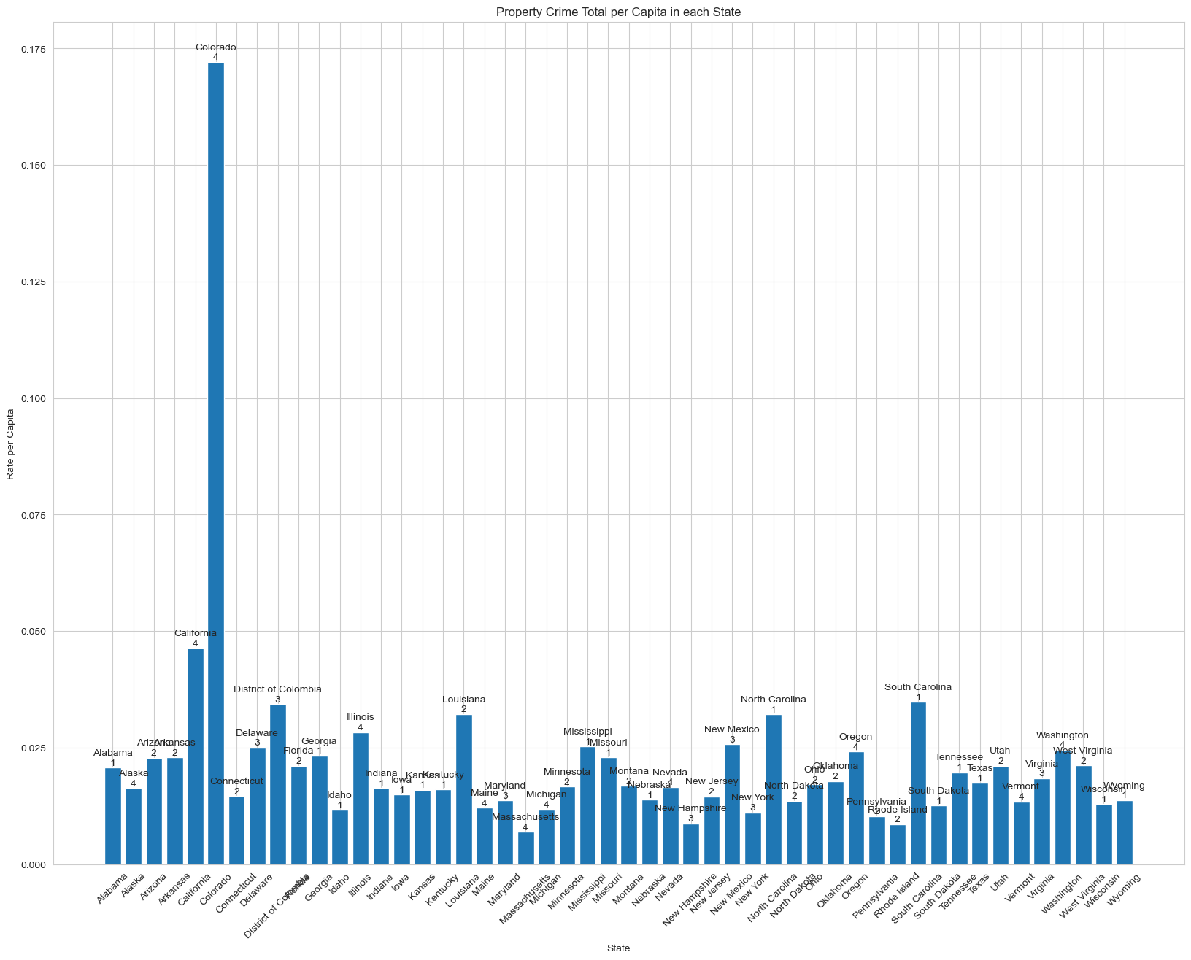
Type of crime by state
Violent Crime by State Property Crime by State

Slide 7
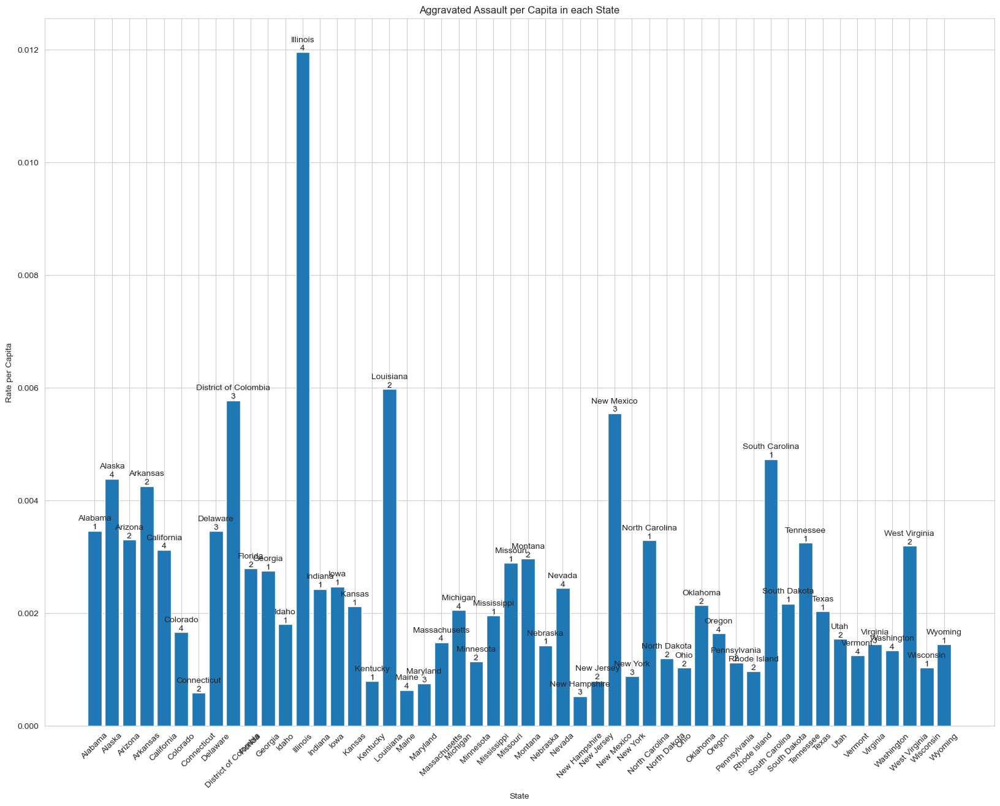
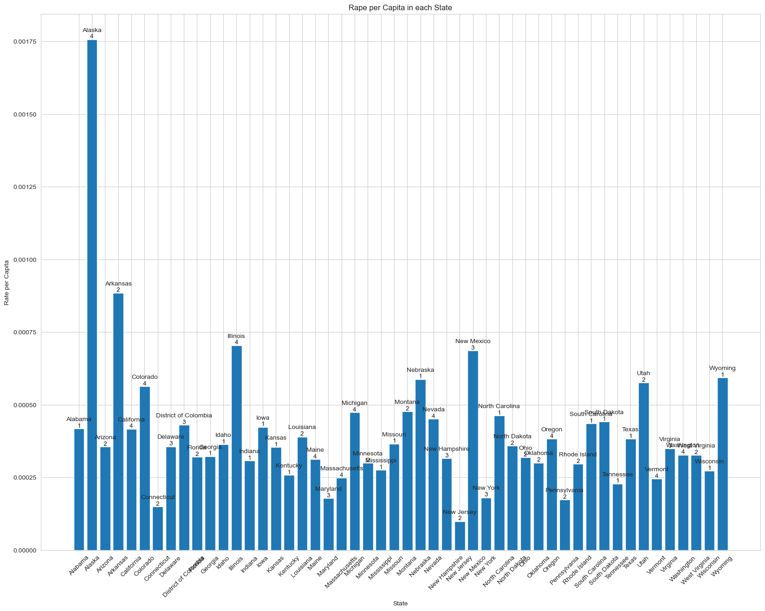
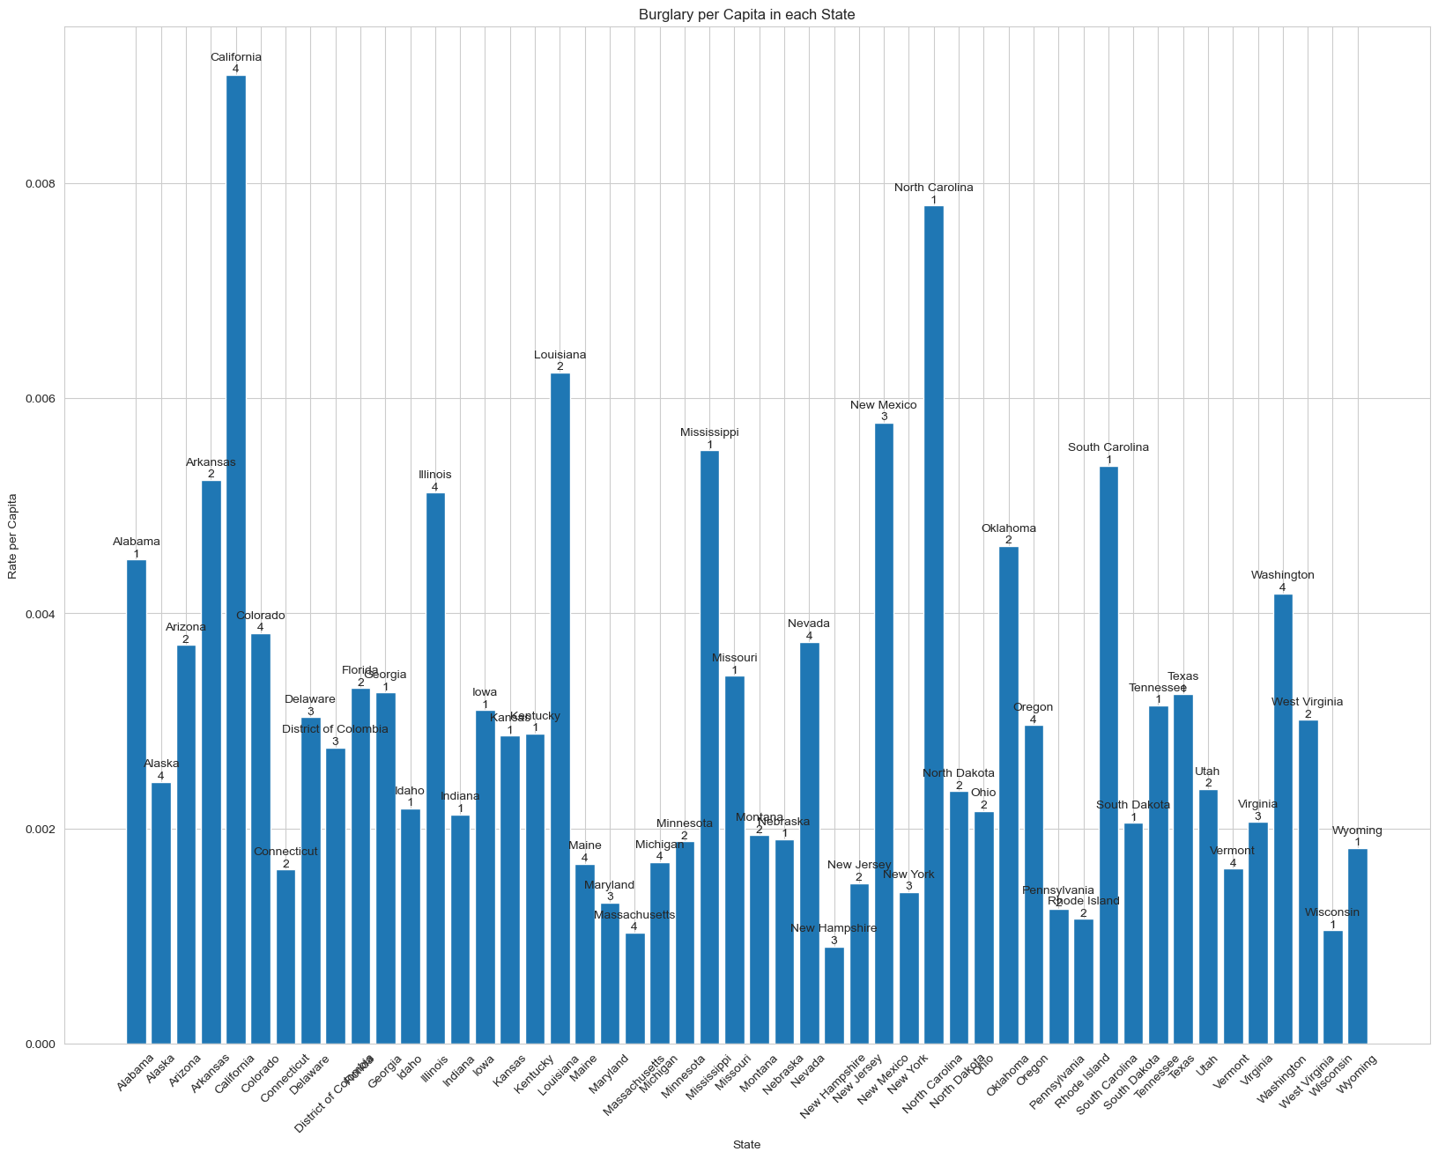
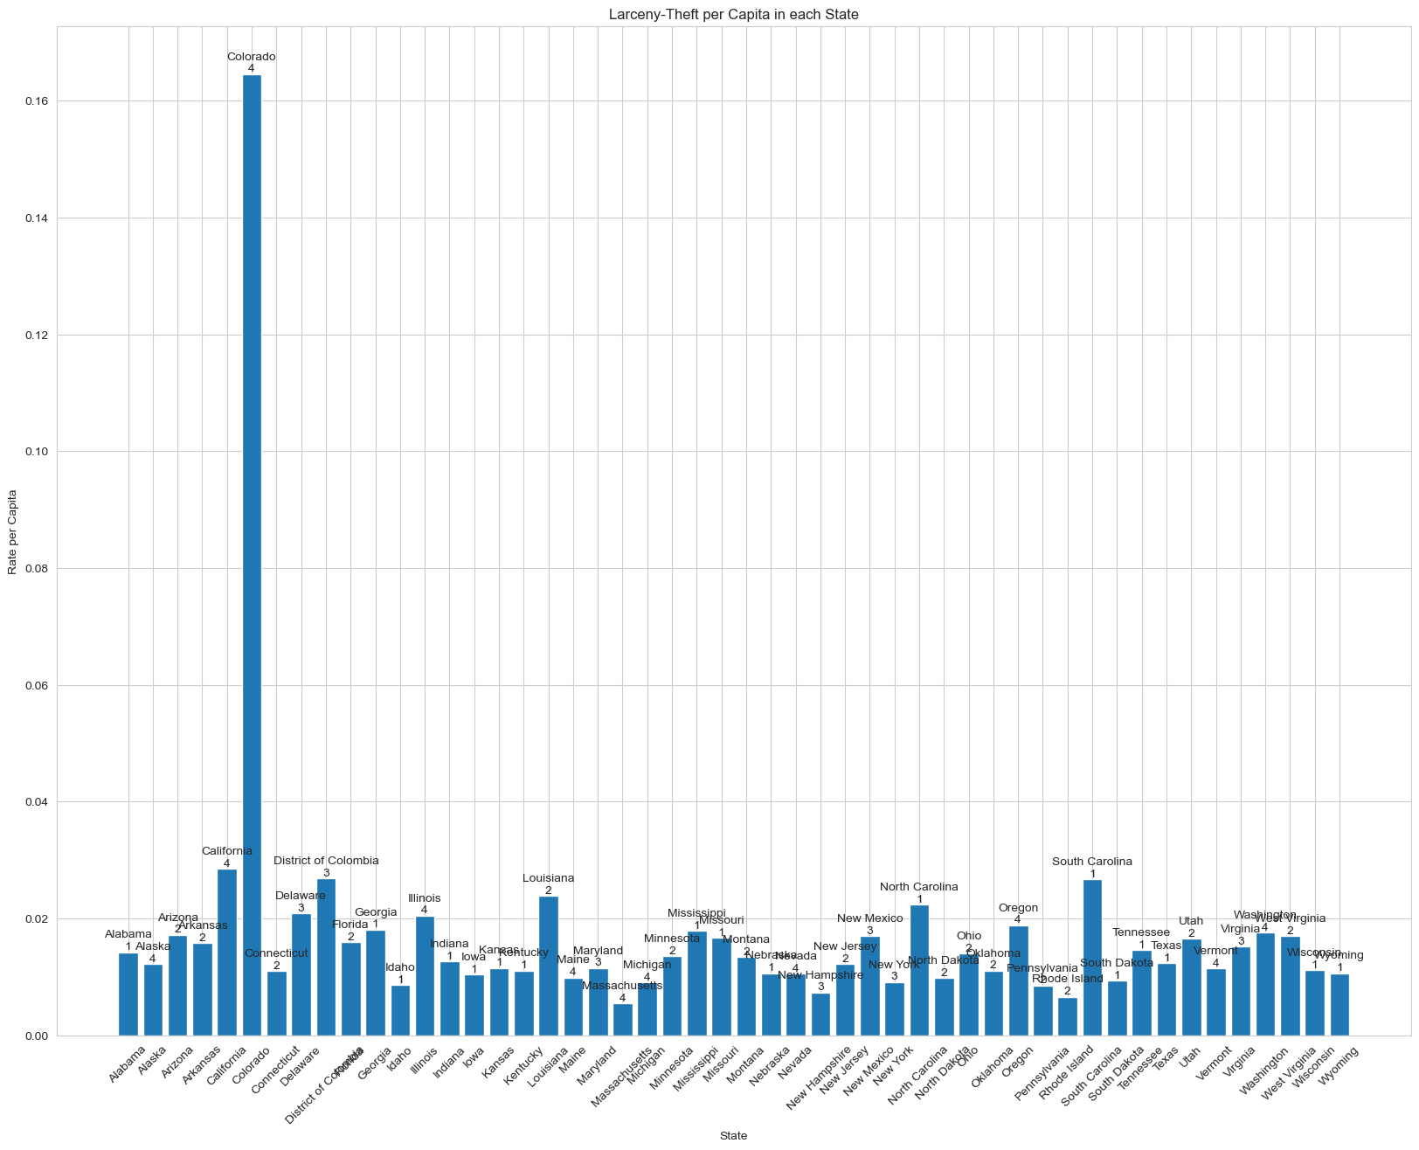
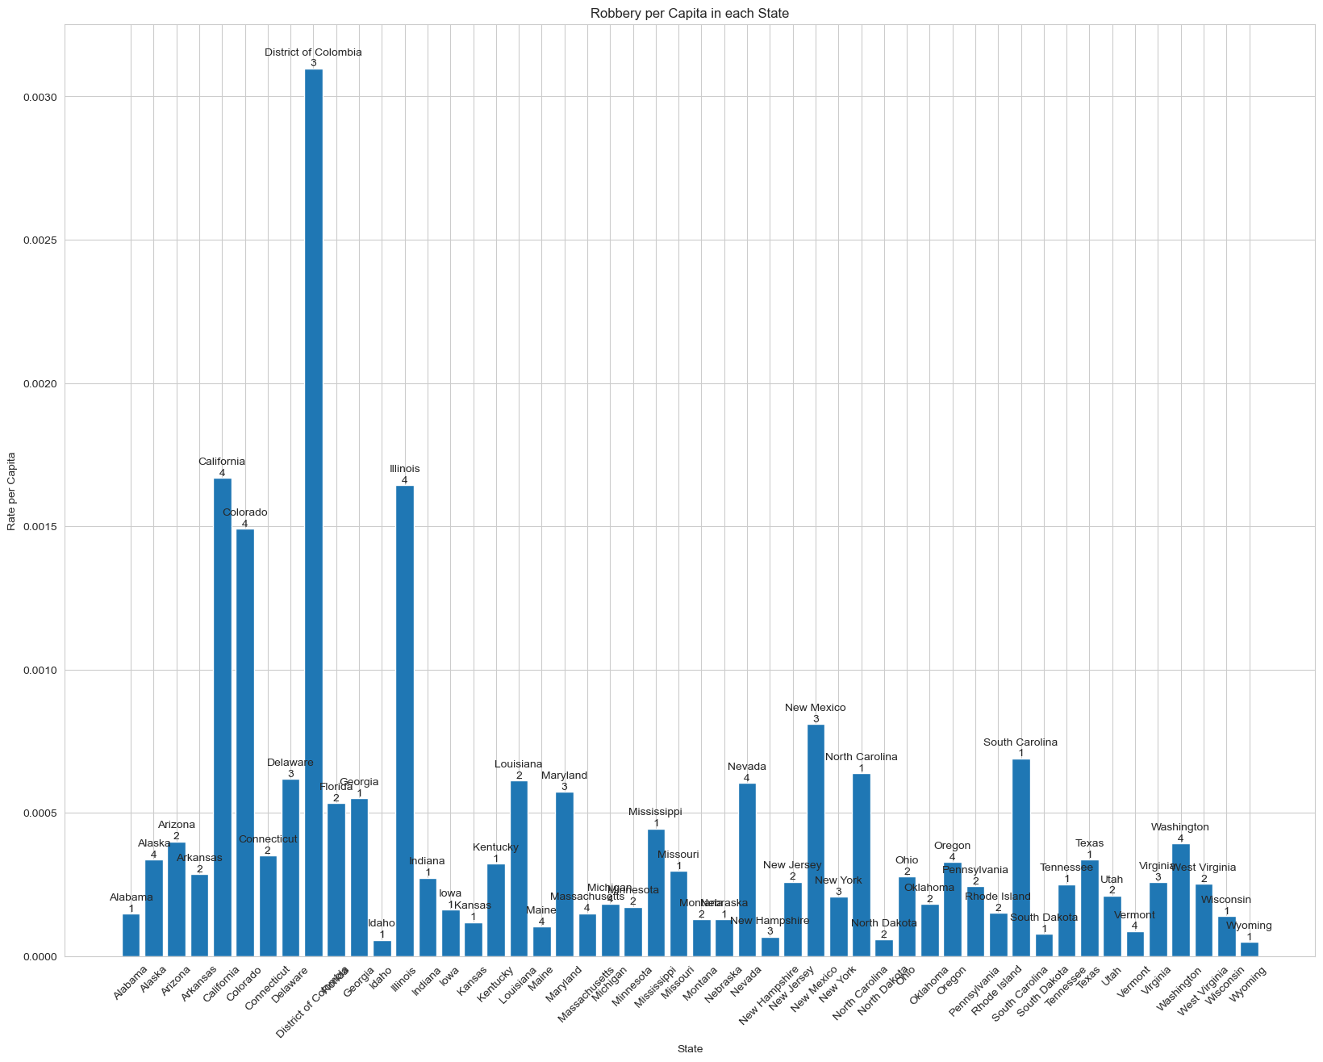
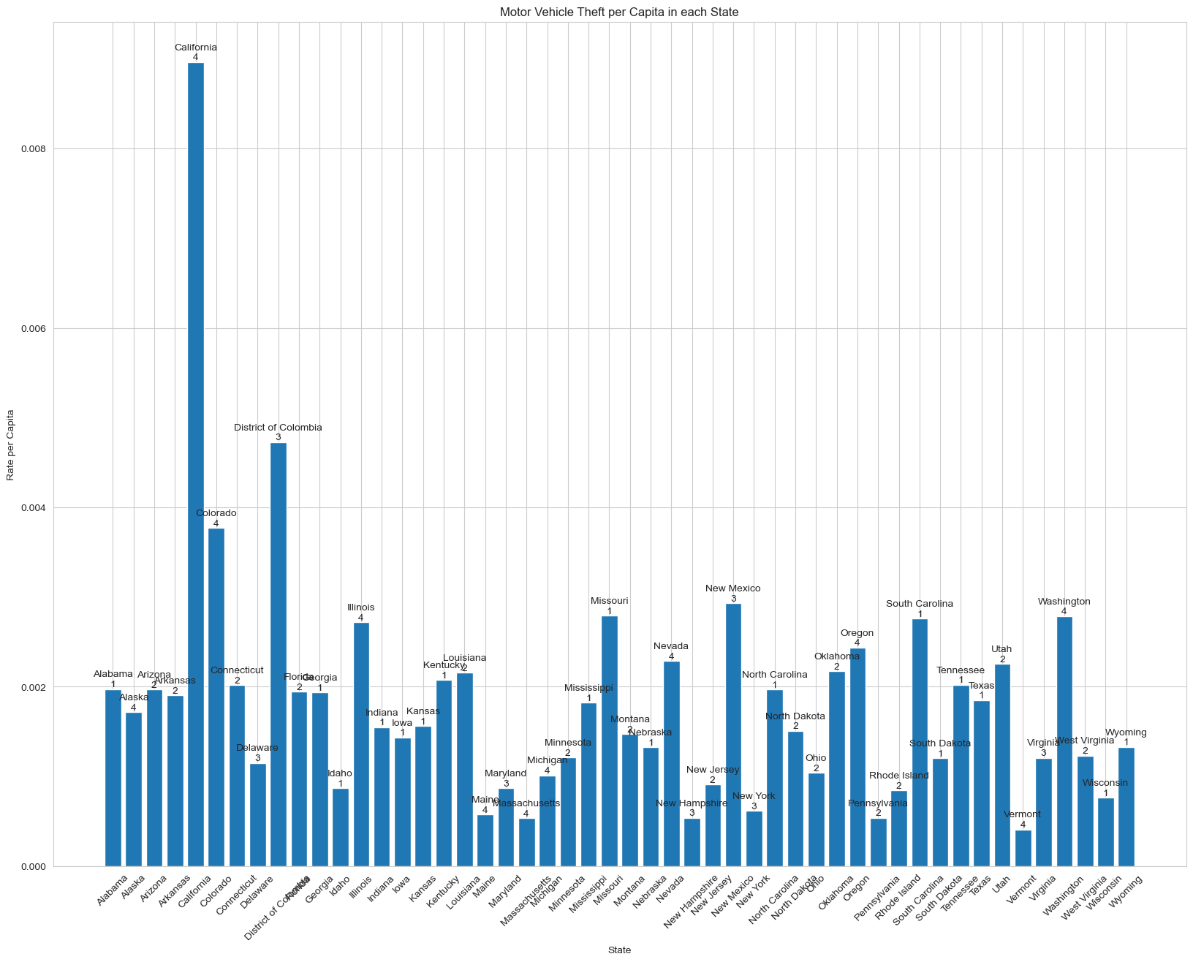
Violent Crime by State Property Crime by State

Slide 8
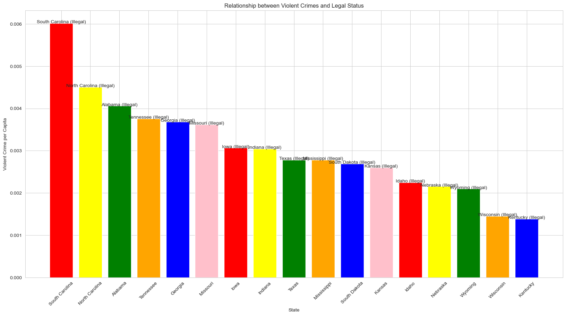
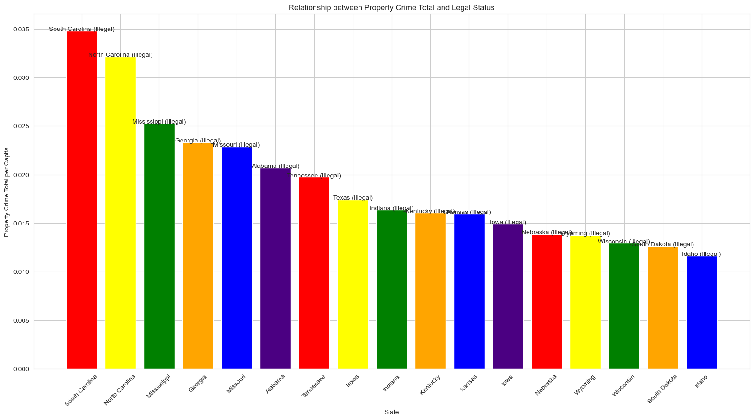
Crime where Cannabis is Illegal
Violent Crime
Property Crime

Slide 9
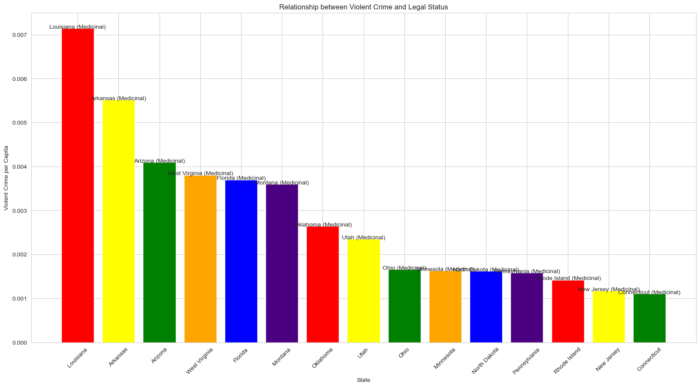
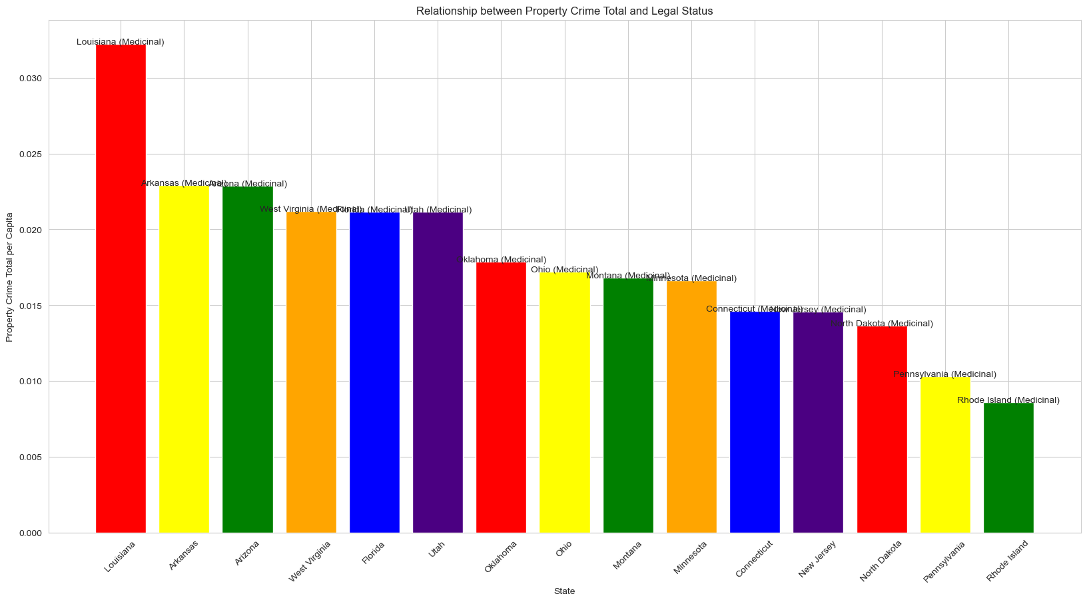
Crime where Cannabis is Medicinal
Violent Crime
Property Crime

Slide 10
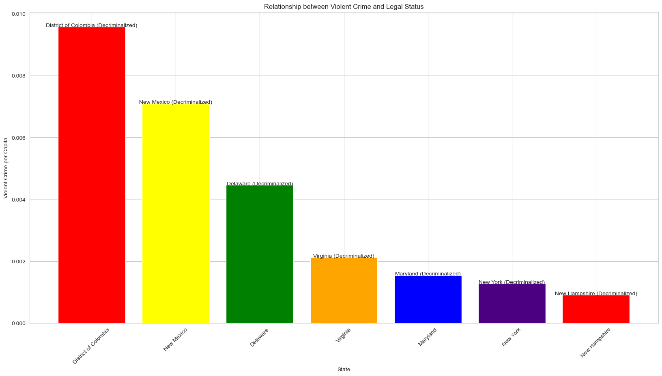
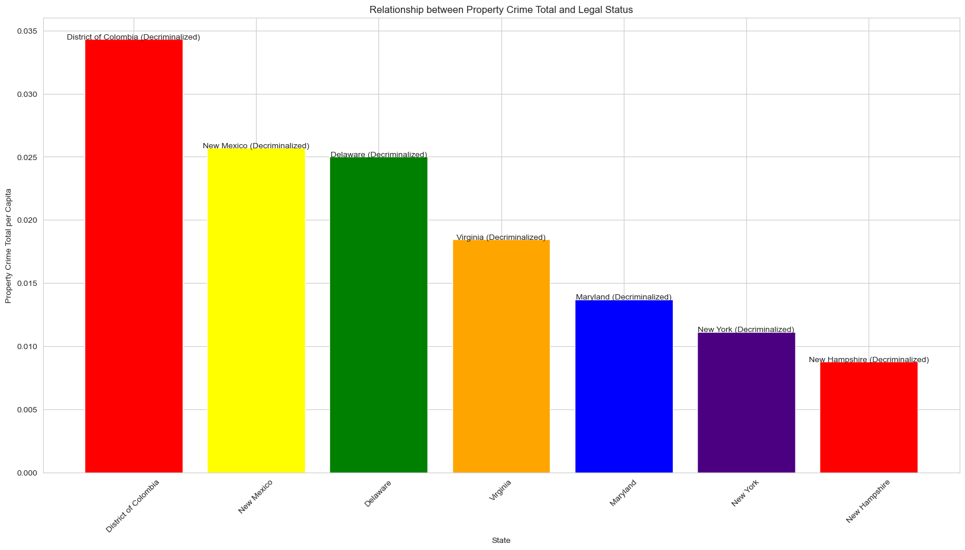
Crime where Cannabis is Decriminalized
Violent Crime
Property Crime

Slide 11
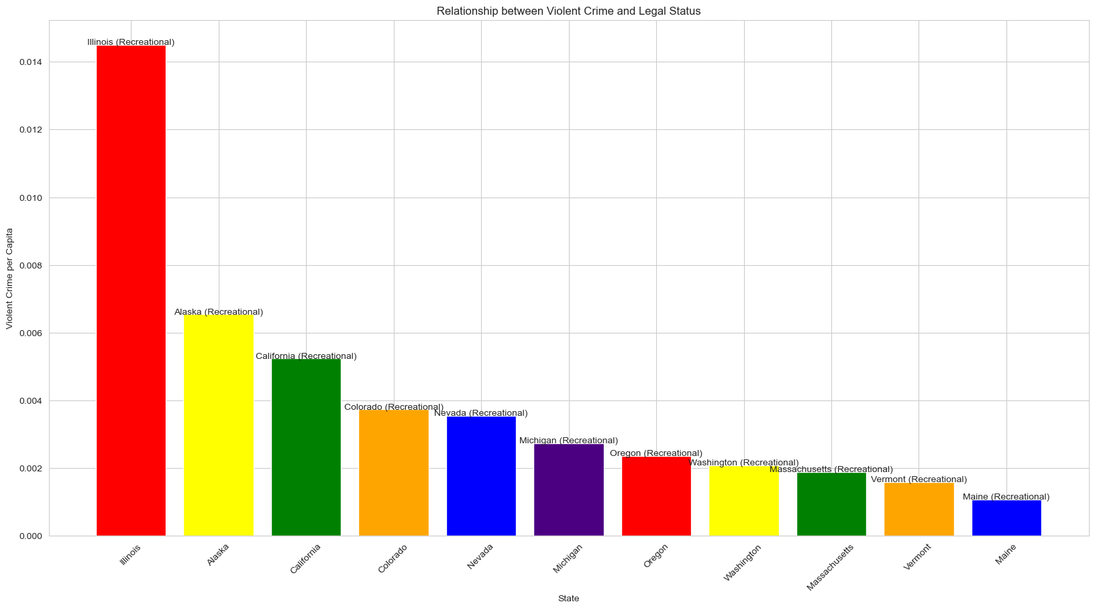
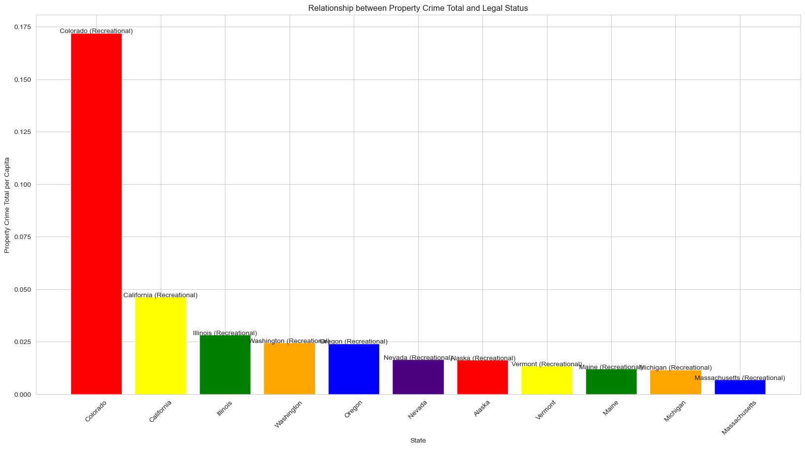
Crime where Cannabis is Recreational
Violent Crime
Property Crime

Slide 12
Talk about ANOVA and how there was frequent statistical difference between the legal status categories, but that these differences seemed to follow a consistent trend.

Slide 13
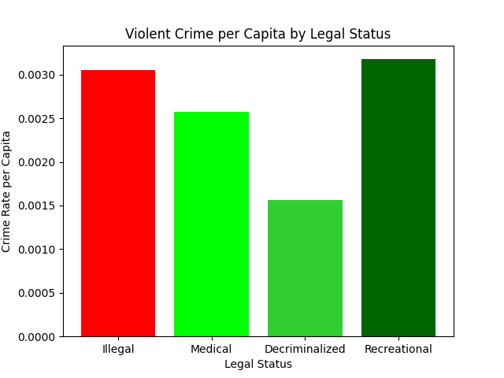
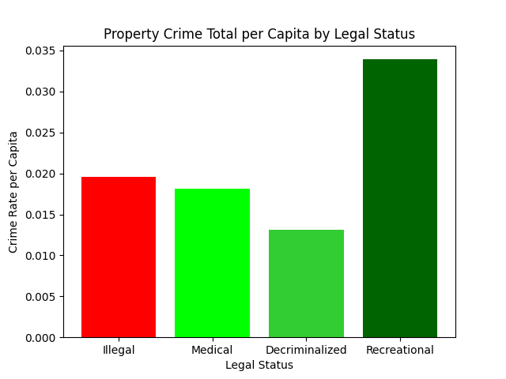
Mean graphs from ANOVA analysis

Slide 14
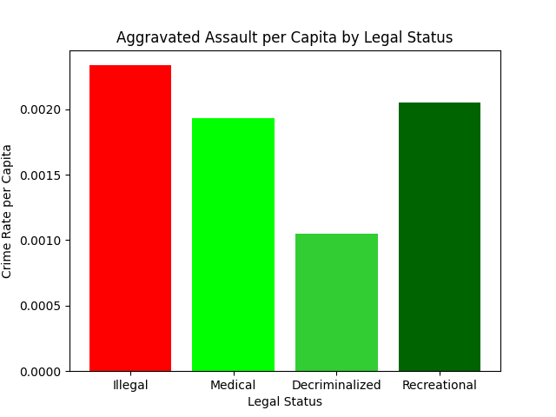
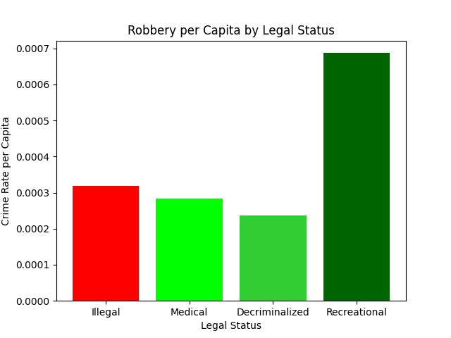
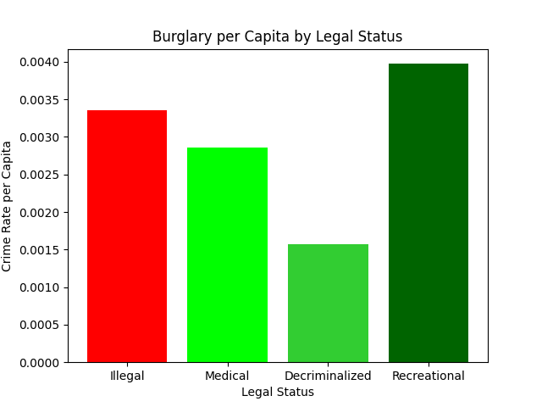
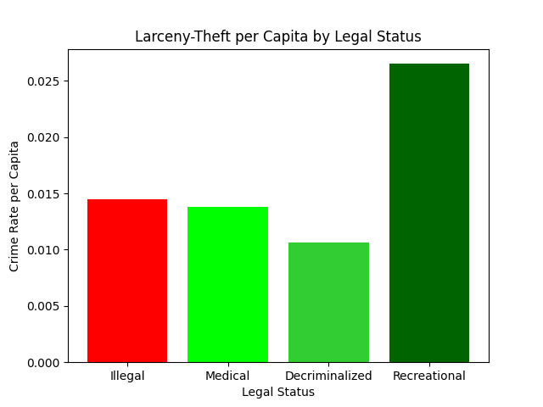
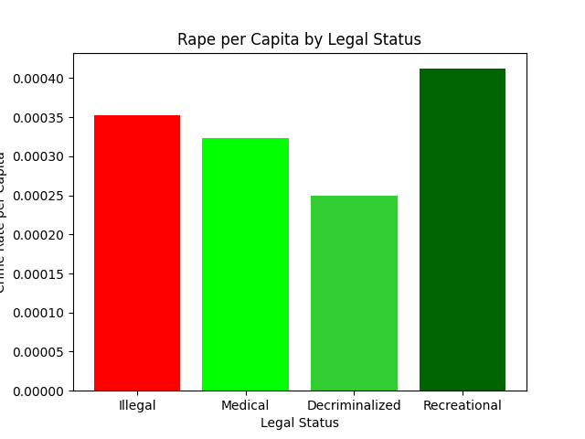
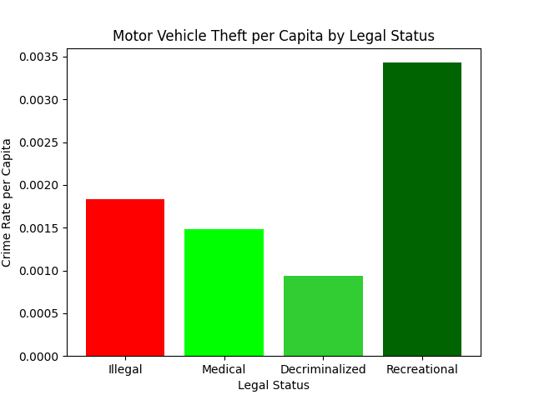
Violent Crime
Property Crime

Slide 15
Kayla Introduces Regression

Slide 16
Regression graphs

Slide 17
Sources
United States Department of Justice, Federal Bureau of Investigation. Crime in the United States Annual Reports, Offenses Known to Law Enforcement, 2020. Retrieved February 2023, from https://cde.ucr.cjis.gov/LATEST/webapp/#/pages/downloads
https://www.themarshallproject.org/2022/06/14/what-did-fbi-data-say-about-crime-in-2021-it-s-too-unreliable-to-tell

